Slide 1

Comparison between ingress controllers and methods to secure web applications and the kube-API server in kubernetes clusters
Presenter → Dikshita Kalita
Supervisor → Prof. Dr. Martin Leischner
Mentor → Richard Clauß
Date → 13.12.2022

Slide 2
Agenda
01
Research Questions
02
Comparison of ingress controllers
03
Securing web applications
04
Securing the kubernetes API
05
Demo
Dikshita Kalita | Kubernetes ingress controllers and security

Slide 3
Research Questions
01
What are the most important differences between
the most commonly used ingress controller implementations?
2. How can web applications running in a kubernetes cluster be secured?
(Determine and compare different methods for authentication and authorization)
3. How can the kubernetes API be secured?
(Determine and compare different methods for authentication and authorization)
Dikshita Kalita | Kubernetes ingress controllers and security
Notes:
What are the most important differences between different ingress controllers?
(Compared implementations: Nginx, Traefik, HAProxy)
2. How can web applications running in a kubernetes cluster be secured?
How can users be authenticated and authorized in kubernetes and how do these methods compare against each other?
Which methods exist to integrate identity providers into kubernetes and for which scenarios they are most suitable?
3. How can the kubernetes API be secured?
How can users be authenticated and authorized in kubernetes and how do these methods compare against each other?
Which methods exist to integrate identity providers into kubernetes and for which scenarios they are most suitable?

Slide 4

02
Comparison of ingress controllers
Dikshita Kalita | Kubernetes ingress controllers and security

Slide 5
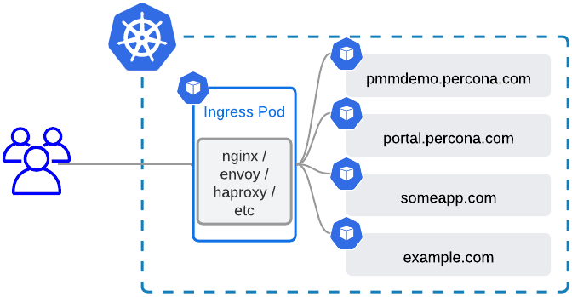
02
Ingress controllers | Introduction
Operate at the application layer and currently only support HTTP and HTTPS.
All requests are sent to a single external IP, which is accessible from outside the cluster
Ingress controllers match URLs to services
Kubernetes resource IngressClass can define different implementations that can be used in parallel
Dikshita Kalita | Kubernetes ingress controllers and security
Notes:
https://www.percona.com/blog/expose-databases-on-kubernetes-with-ingress

Slide 6
02
Ingress controllers | Types
Cloud-based
(configures API Gateway of the cloud)
Types
2. Self-hosted
(hosted as pods inside kubernetes)
Dikshita Kalita | Kubernetes ingress controllers and security

Slide 7




02
Ingress controllers | Choosing software
Problem:
Results (Winners) :
Tremendous amount of IngressController implementations
(There are multiple implementations for each web-server)
HAProxy → voyager (1.3k )
Nginx → ingress-nginx (14k )
Traefik → Traefik (40.8k )
Approach:
For each web-server include most commonly used IngressController implementation, which is based on it in the comparison.
Popularity is determined by amount of github stars
Dikshita Kalita | Kubernetes ingress controllers and security

Slide 8
02
Ingress controllers | Comparison
 | ingress-nginx | voyager | Traefik
Based on | nginx | haproxy | traefik
Supported protocols | HTTP 1/2 = tcp HTTP 3 = udp TLS | HTTP 1/2 = tcp HTTP 3 = udp TLS | HTTP 1/2 = tcp HTTP 3 = udp TLS
Traffic routing capabilities | Host Path Headers Method Query Params | Host Path | Host Path Headers Method Query Params
Load Balancer Algorithms | Round robin Sticky Sessions Ring Hash Exponential-Weighted- Moving-Average | Round robin Sticky Sessions Least Connections | Round Robin Sticky Sessions External load balancing
Dikshita Kalita | Kubernetes ingress controllers and security

Slide 9

02
Ingress controllers | Preference
IngressController choosen for subsequent work: Traefik
Header-based routing
Automatically enables HTTP2
Supports automatic certificate renewal
High performance and stability
Dikshita Kalita | Kubernetes ingress controllers and security

Slide 10

03
Securing
web applications
Dikshita Kalita | Kubernetes ingress controllers and security

Slide 11

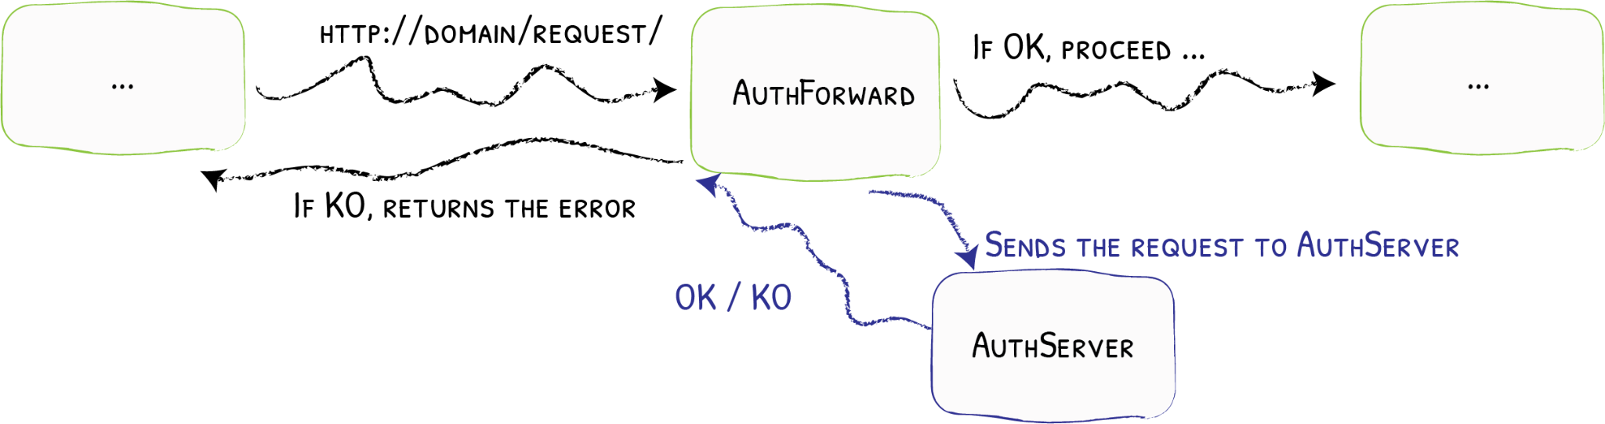
03
Securing web-apps | Possibilities
How can an ingress controller handle authentication and authorization if it is deployed as reverse proxy in front of an web-application?
1. Do nothing
→ “Authorization” header and cookies forwarded without modification
2. IngressController protects backend by requiring a login
→ For example basic authentication
→ Backend still independent, but may receive “Trusted Headers” for Single-Sign-On
3. IngressController uses external authentication server
Dikshita Kalita | Kubernetes ingress controllers and security
Notes:
Client does basic auth with server -> basically a http header
Who is server? Application behind nginx or nginx itself?
1. nginx can be configured to be the auth server itself
2. but nginx can also as reverse proxy forward the http header of basic auth to the actual application
3. Nginx can ask a authentication and authorization server for permission to forward the request
In the big table method 1 is meant primarly
But there is a row ExternalAuth, which refers to method 3

Slide 12
04
Securing Kubernetes
Dikshita Kalita | Kubernetes ingress controllers and security

Slide 13
04
Securing Kubernetes | Introduction
Image registry
UI
Node 1
Master Node
Node 2
API
CLI
Node 3
.
.
.
Node n
Fig: Architecture in bigger picture
Dikshita Kalita | Kubernetes ingress controllers and security

Slide 14

04
Security in Kubernetes | Access Control
Kubernetes is not a security platform
Solution:
Kubernetes Security Pipeline
No native tools to handle security-related tasks
Consists of modular and exchangeable parts
No vulnerability detection for applications
Main component to protect:
No monitoring for attacks and breaches
Kube API
Dikshita Kalita | Kubernetes ingress controllers and security

Slide 15






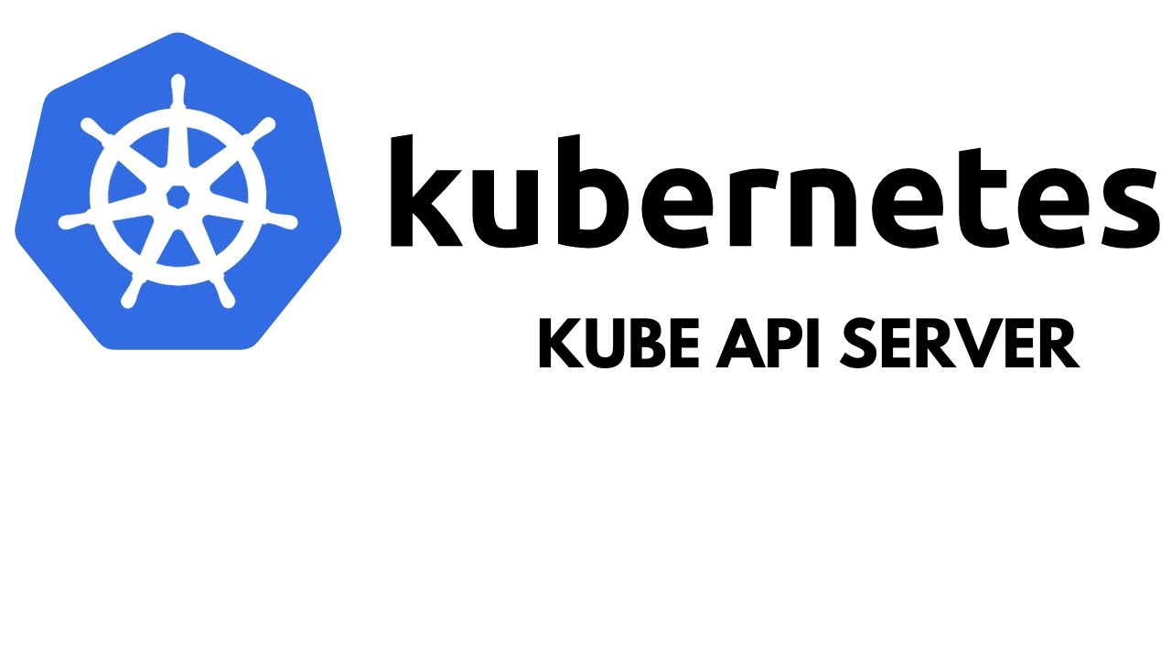
04
Security in Kubernetes | Security Pipeline
Human user
Authentication
2. Authorization
3. Admission Control
confirm and find out identity
define via policies what an individual identity or group may access
Additional layer for intercepting requests, can modify them
Kubernetes object (s)
Pod/ServiceAccount
Fig: Kubernetes security pipeline, Source: Click here
Dikshita Kalita | Kubernetes ingress controllers and security
Notes:
Authentication = confirm and find out identity
Authorization = define via policies what an individual identity or group may access
Access control = methods we use to enforce such policies
admission controller= is a piece of code that intercepts requests to the Kubernetes API server prior to persistence of the object, but after the request is authenticated and authorized.
-> one additional layer to extend the (already existing) access control
Source:
https://www.icann.org/en/blogs/details/what-is-authorization-and-access-control-2-12-2015-en
https://www.sailpoint.com/identity-library/difference-between-authentication-and-authorization/

Slide 16
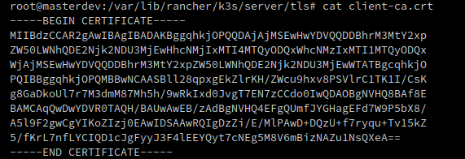
04
Security in Kubernetes | Authentication
Static Token File
X509 Client Certificates
Dynamically managed Tokens
Pass a CSV with the following:
<token>,<username>,<UID>,”<group1, group2>”
<token>,<username>,<UID>,”<group2, group4>”
OpenID Connect (OIDC)
(HTTP Bearer authentication)
(HTTP Bearer authentication)
Insecure
Not scalable
Long-lived and can’t be revoked effectively
Makes it hard to use groups with RBAC
Dikshita Kalita | Kubernetes ingress controllers and security
Notes:
https://developer.mozilla.org/en-US/docs/Web/HTTP/Authentication

Slide 17

04
Security in Kubernetes | Categories of users
Humans
Service Accounts
Dikshita Kalita | Kubernetes ingress controllers and security

Slide 18

04
Security in Kubernetes | Human users
Kubernetes does not have
RELIES on a variety of techniques to delegate that
User, profile database / lookup table to store usernames, passwords to store usernames, passwords
Instead
For human users
i.e.
NO API calls to create user
Dikshita Kalita | Kubernetes ingress controllers and security

Slide 19

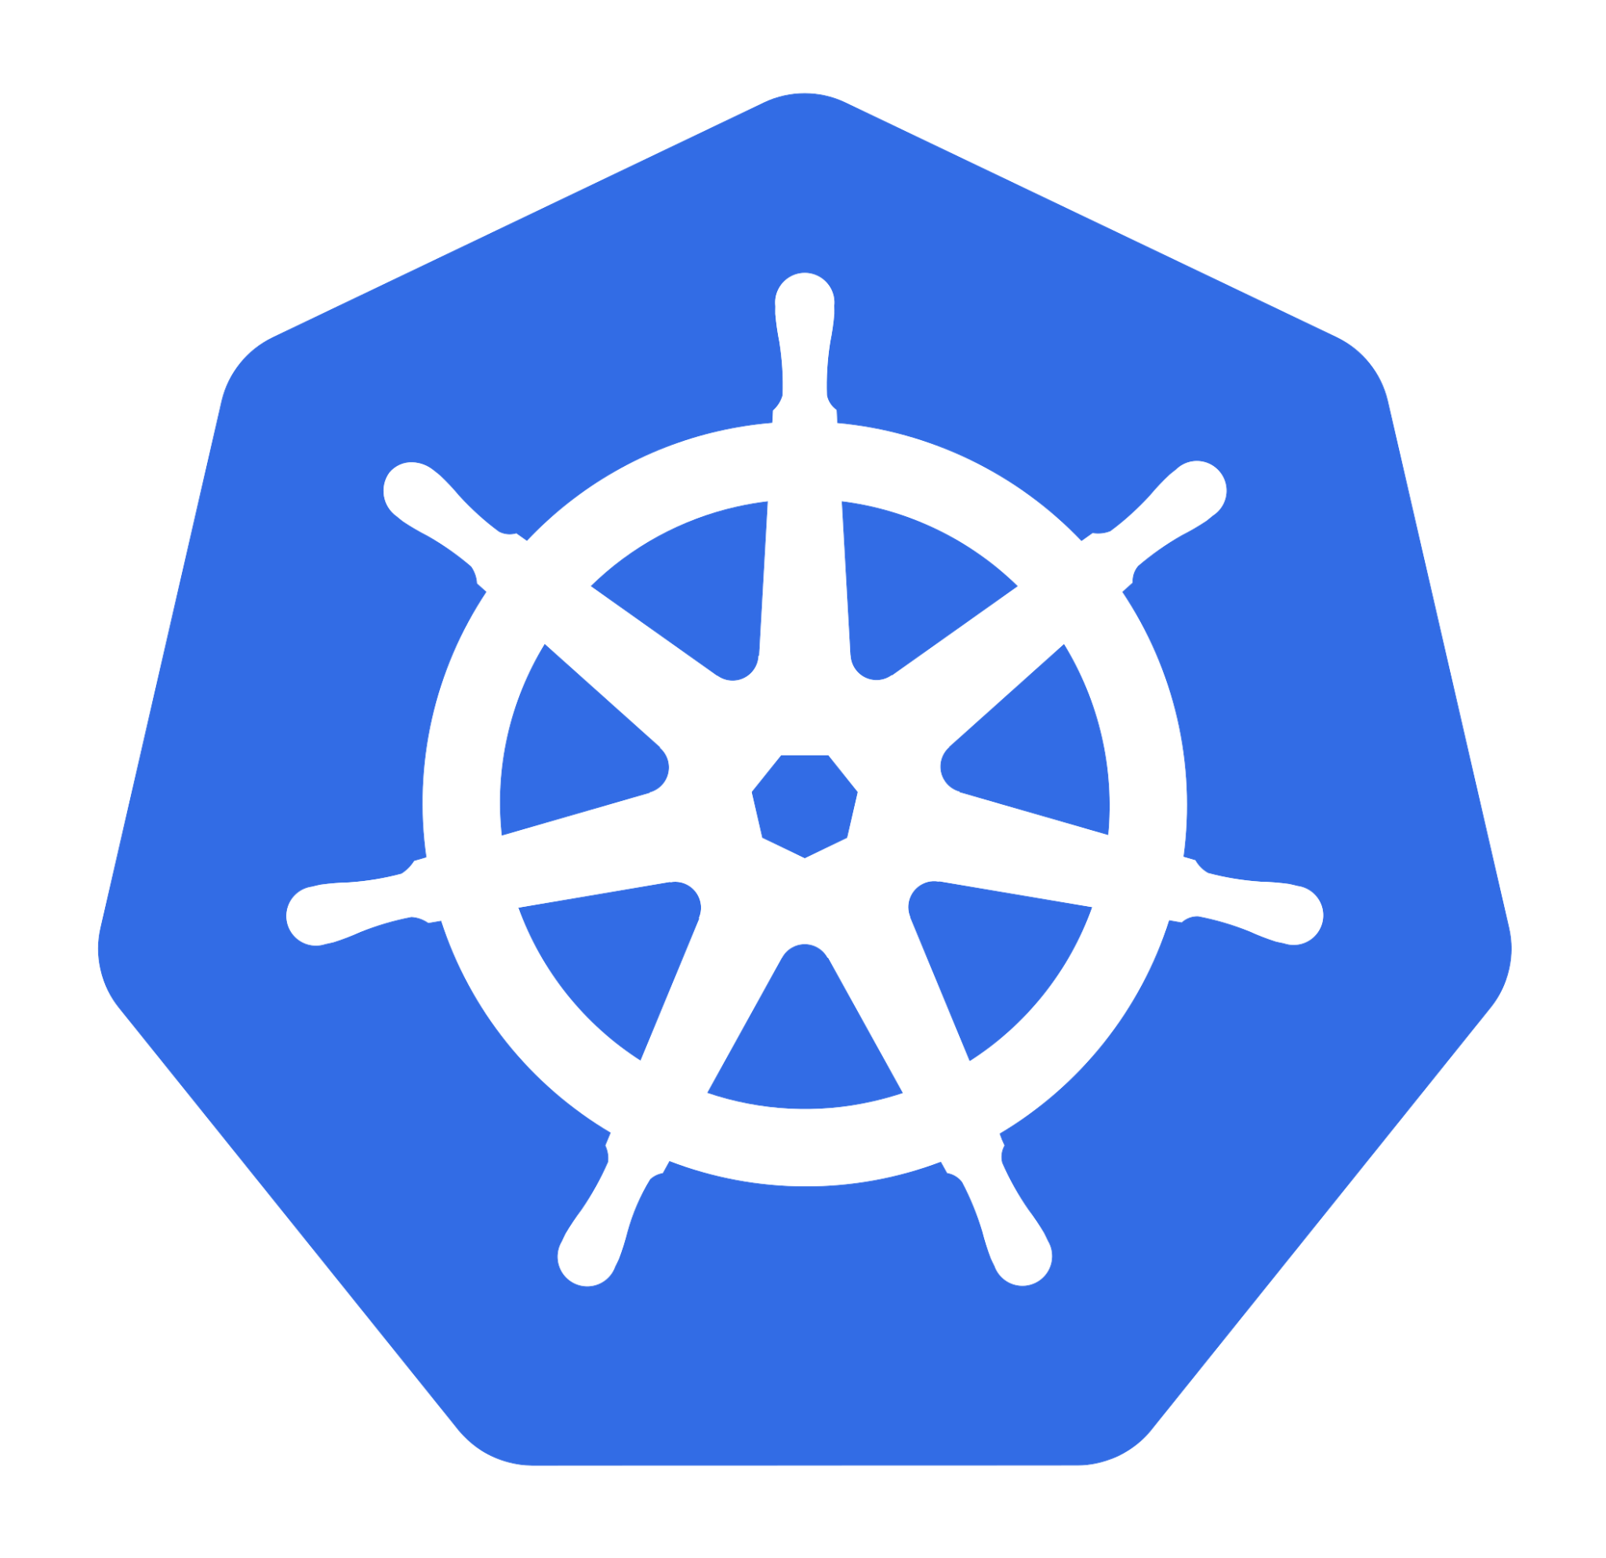

04
Security in Kubernetes | Service Accounts
Service Account / SA is
1. Internal representation of a set of credentials that are typically stored as Secrets.
Accesses
Through
Service Accounts
2. Pods uses this SA to authenticate when they talk to internal API endpoint
3. By default, SA have no access permissions but can be configured using RBAC to give them access permission and role-based control so they can query and manipulate
Dikshita Kalita | Kubernetes ingress controllers and security

Slide 20
04
Security in Kubernetes | Service Accounts
Very useful if we have an automatized application set-up in the cluster to deploy the pods after its build up
2. Create a Role:
k3s kubectl apply -f default-role.yaml
3. Create a RoleBinding:
k3s kubectl apply -f role-binding.yaml
Dikshita Kalita | Kubernetes ingress controllers and security

Slide 21

04
Security in Kubernetes | Authorization
Authorization modules:
1. It evaluates attributes or characteristics in order to determine the access
AlwaysAllow
Not for production but for specified use-case
2. AlwaysDeny
2. The administrator defines a set of user authorization policies into a file with one JSON per line format.
3. Node
Using this node or kubelet would talk to API server
Any modification in the file requires API server to be restarted.
4. Attribute-Based Access Control (ABAC)
1. Here we define Roles and with these roles a user can access kubernetes objects
5. Role-based Access Control (RBAC)
6. Webhook
We can connect multiple webhooks for authorization
Dikshita Kalita | Kubernetes ingress controllers and security

Slide 22

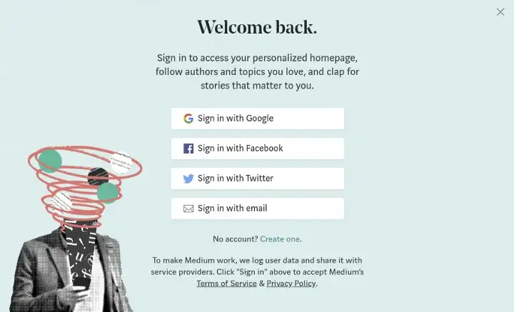

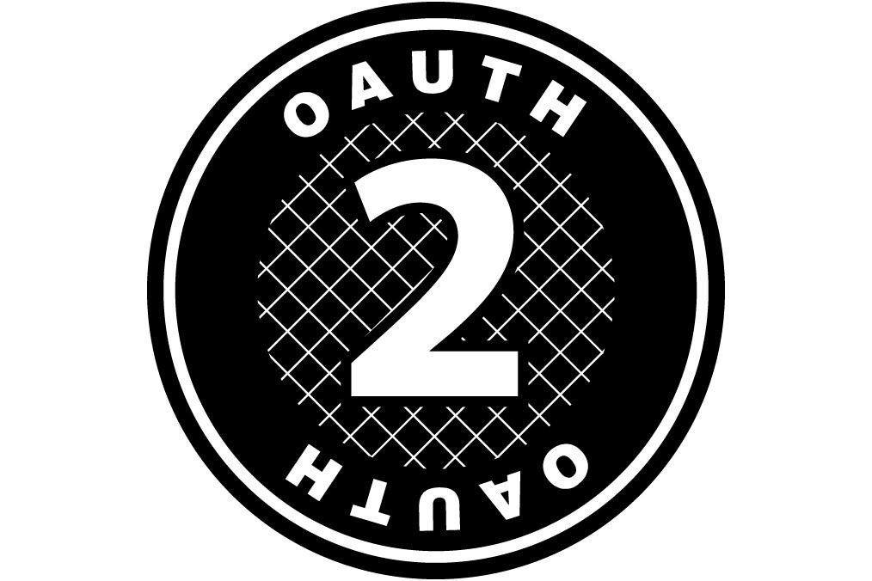
04
Security in Kubernetes | Auth | OIDC
OpenID Connect or OIDC is an identity protocol that can be used for authorization and authentication
2. It aims to be easy to use and extends the existing technology OAuth2.0
3. Typical use-case: Identity Federation
Simple identity layer for Authentication
Standard protocol for Authorization
Dikshita Kalita | Kubernetes ingress controllers and security

Slide 23











04
Security in Kubernetes | Auth | OIDC
User
Identity Provider
kubectl
API Server
Login to IDP
Provide access_token,id_token, & refresh_token
Call Kubectl with --token being the id_token OR add tokens to .kube/config
Authorization: Bearer
Is JWT signature valid?
Has the JWT expired? (iat+exp)
User authorized?
Authorized: Perform action and return result
Return result
User
Identity Provider
kubectl
API Server
Dikshita Kalita | Kubernetes ingress controllers and security

Slide 24

04
Security in Kubernetes | OIDC | IdP
A system entity that creates, maintains, and manages identity information for users and also provides authentication services to relying applications.
Does Kubernetes provide an OpenID Connect Identity Provider ?
Solution ?
Dikshita Kalita | Kubernetes ingress controllers and security

Slide 25
04
Security in Kubernetes | OIDC | IdP
We can
Use an existing public OpenID Connect IdP
2. Run our own Identity Provider
Google
Keycloak
Microsoft
Dex
Amazon
CloudFoundry User Account and Authentication
Okta
Tremolo Security's OpenUnison
PayPal
SalesForce
PhantAuth
Github
Dikshita Kalita | Kubernetes ingress controllers and security

Slide 26


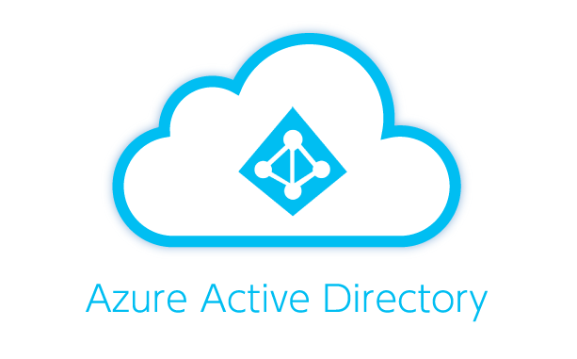


04
Security in Kubernetes | OIDC | IdP
Keycloak
Dex
Complex to operate since it needs standalone database
Simple and easy to set up
Scenario:
Scenario:
webapps
Existing IdP
DEX
Keycloak
IdP
OIDC interface
Dikshita Kalita | Kubernetes ingress controllers and security

Slide 27

04
Security in Kubernetes | Demo
Dikshita Kalita | Kubernetes ingress controllers and security

Slide 28
Sources (1/2)
01. Kubernetes (Publisher). (no date). Accessed on 13. December 2022
from https://kubernetes.io/docs/reference/access-authn-authz/authentication
02. TremoloSecurity (Publisher). (no date). Accessed on 13. December 2022
from https://www.tremolosecurity.com/post/kubernetes-dont-use-certificates-for-authentication
03. Hitesh Jethva. (04.04.2022). Accessed on 13. December 2022
from https://cloudinfrastructureservices.co.uk/oauth2-vs-openid-whats-the-difference/
04. Sysdig (Publisher). (no date). Accessed on 13. December 2022
from https://sysdig.com/learn-cloud-native/kubernetes-security/kubernetes-rbac/
05. Geeksforgeeks (Publisher). (11.07.2022). Accessed on 13. December 2022
from https://www.geeksforgeeks.org/types-of-authentication-protocols/
06. Schuyler Brown. (23.09.2022). Accessed on 13. December 2022
from https://www.strongdm.com/blog/oidc-vs-saml#:~:text=OIDC%3A%20What's%20the%20Difference%3F,to%20obtain%20the%20security%20token
07. Rob Sobers. (05.04.2012). Accessed on 13. December 2022
from https://www.varonis.com/blog/what-is-oauth
08. Dinika Senarath. (28.09.2018). Accessed on 13. December 2022
from https://dinika-15.medium.com/identity-federation-a-brief-introduction-f2f823f8795a
09. Wikipedia (Publisher). (no date). Accessed on 13. December 2022
from https://en.wikipedia.org/wiki/Identity_provider
10. metal-k8s (Publisher). (no date). Accessed on 13. December 2022
from https://metal-k8s.readthedocs.io/en/latest/developer/architecture/authentication.html
11. Scott Chang. (28.06.2020). Accessed on 13. December 2022
From https://medium.com/@sct10876/keycloak-vs-dex-71f7fab29919
Dikshita Kalita | Kubernetes ingress controllers and security

Slide 29
Sources (2/2)
12. Traefik (Publisher). (no date). Accessed on 13. December 2022
from https://doc.traefik.io/traefik/v2.0/middlewares/forwardauth/
Dikshita Kalita | Kubernetes ingress controllers and security

Slide 30

Note of gesture
Thank you for your attention and patience
Dikshita Kalita | Kubernetes ingress controllers and security

